Slide 1
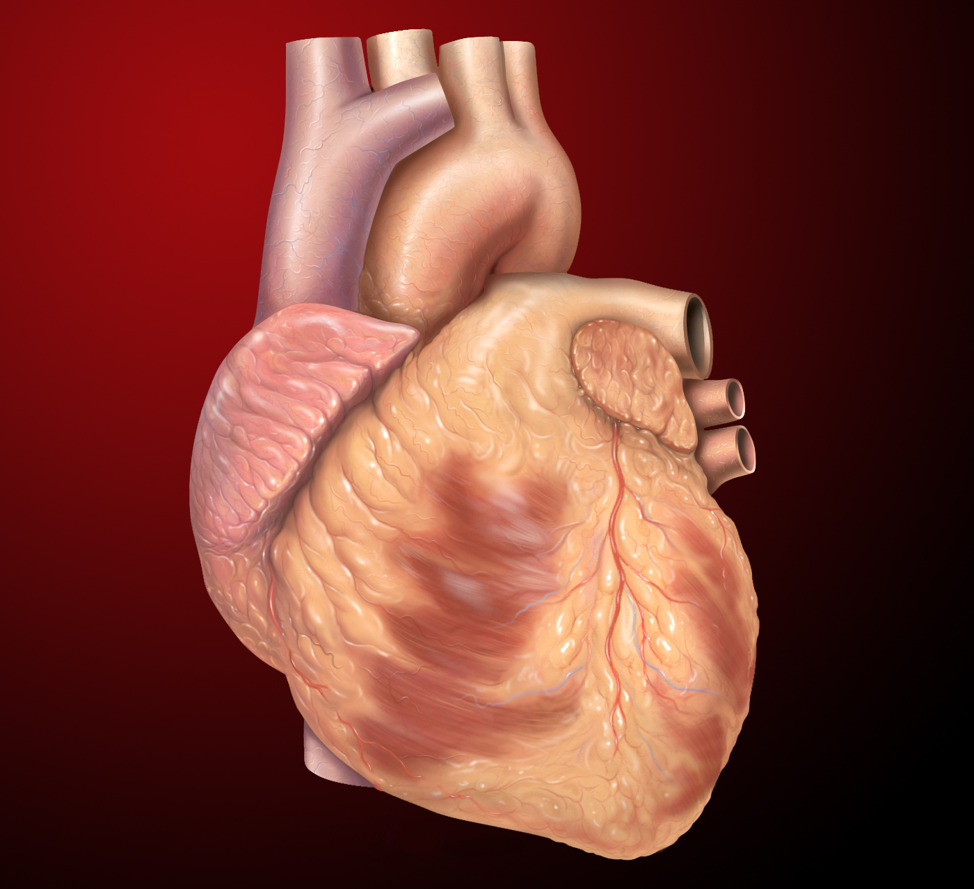
Comparative Machine Learning Models for Heart Disease
By Bimi, Eric, Kenny, and Marc

Slide 2

Data description
Data was obtained from Kaggle and CDC/NVSS
We cleaned and renamed the file
54.46% have heart disease, 45.54% don’t
31.68% female, 68.32% male
Min age: 29
Max age: 77
Mean age: 54
Notes:
National Vital Statistics System

Slide 3

Machine Learning
Models: ...
Percentages: ...

Slide 4
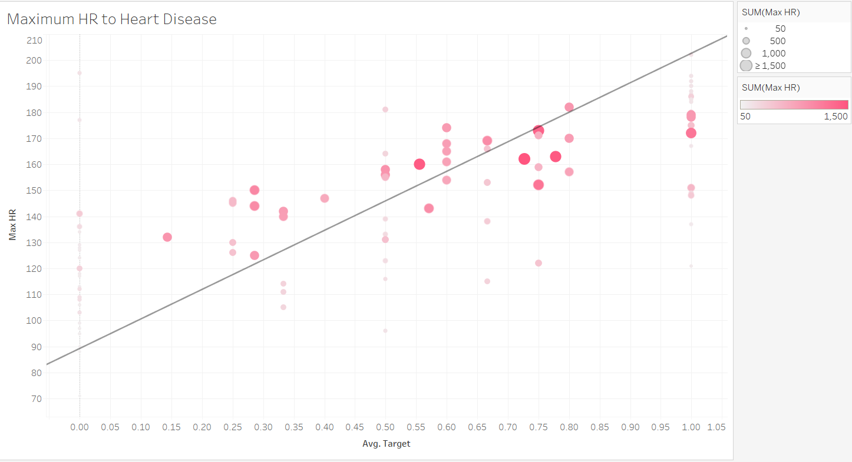

Slide 5
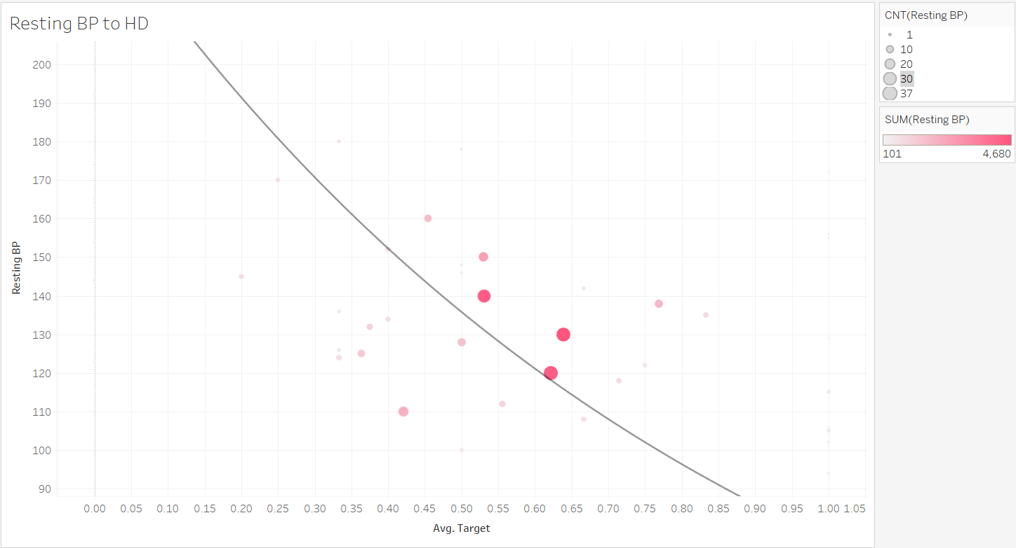

Slide 6
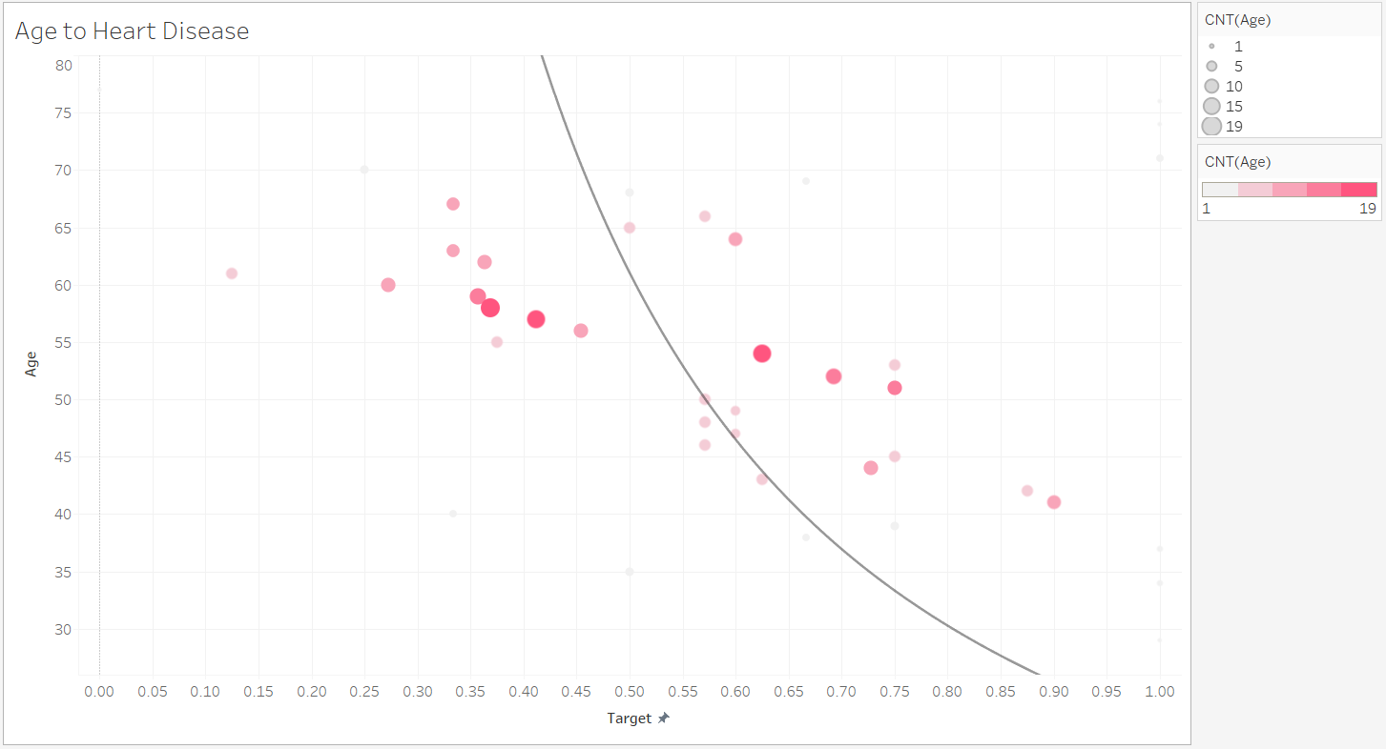

Slide 7
Machine learning graphics...

